Slide 1

Enhancing Credit Card Approval Rate with Machine Learning
Presenter: Sumali Wickramarachchi
Notes:
Welcome, everyone. Today, I'll walk you through our journey of enhancing credit card approval rates using machine learning.

Slide 2


Current State of Credit Card Approval Process
Quest for enhancement
The Call to Adventure
AI enhanced Credit Card Approval Process
Data Transform
Classification
Validation
Regulatory Compliance
Personalised interest rates
Various stages from initial submission
Multiple credit committee process reviews
Operational Excellence
Profitability
Customer disputes
96% longer review periods vs instant approvals
Customer Satisfaction
Customer Dissatisfaction
Notes:
Imagine a world where credit card approvals are a constant challenge? This is the ordinary world we start our journey in today.
Picture this: the call to adventure arrives. It's a quest for enhancement.
We're not content with the status quo. We're on a mission to revolutionize credit card approvals. Our aim? To identify the low-risk applicants that could be the backbone of profitability.
Our goal is to uncover hidden treasures - not just high-risk applicants but the often-overlooked low-risk gems. Get ready for a journey that transforms this landscape using predictive machine learning model to identify High risk and low risk individals simple as based on their application information which leverage credit card applicants to estimate the likelihood of future defaults and credit card usage. Allowing financial institutions can make informed decisions regarding the issuance of credit cards to applicants, allowing them to objectively quantify potential risks and approve applications easily.
The challenge in the credit card industry is not just identifying high-risk applicants but also identifying those who are low risk.
Our objective is to predict low-risk individuals using credit card applicant data, streamlining approval processes.

Slide 3

Refining our tools
Setting up Y variable
Missing Values & Duplications
Outliers
Feature Engineering
Explorative Analysis
Notes:
Before embarking on any epic journey, one must prepare. Our preparation involves refining our tools.
Think of data preparation as our armor - it must be pristine. It ensures we're ready for the challenges we'll face on this quest.
To make precise predictions, we began with thorough data refinement.
We ensured data quality by meticulously handling missing values and outliers, making it perfect for our analysis.
Currently we do not have a clear dependant variable to predict whether these applications will get approve or not. Based on data we need a predictor to showcase what continuous variable will lead to credit card default risk and transform the field to predict & showcase approval rate by recognising default risk.
I have decided to classify users who have overdue payments of more than 60 days as the target risk group. These specific samples will be labeled as '1', while all others will be labeled as '0'. This approach will help to narrow down the focus to the subset of users who exhibit a higher risk of credit card default, in line with the desired industry benchmark.

Slide 4

The First Tests
Baseline Model: Logistic Regression Model
Accuracy: Model accuracy is approximately 98.53%, indicating its overall performance.
Precision: Precision for 'not high risk' is high at 99%, but for 'high risk,' it's 0%.
Recall: Excellent recall for 'not high risk' at 100%, but 0% for 'high risk.'
F1-Score: High F1-score (around 0.99) for 'not high risk,' but 0 for 'high risk.'
Notes:
Every hero starts somewhere. Our journey kicks off with our baseline model.
We're like young adventurers, confronting our first trials without any special powers. The challenges we encounter will shape our path.
As the dataset include lots of categorical variables, I needed to decide which machine learning model will best suit. Linear regression is typically used for predicting continuous numerical values, not for binary classification tasks like predicting "High risk" or "Not high risk." For binary classification tasks, logistic regression is a more suitable choice because it models the probability of belonging to a particular class.
s our model perform well with identifying non risk categories vs risky categorical, we want to still improve by re-examing the data variables

Slide 5


Iteration 1
Iteration 2
Iteration 3
The Allies and Enemies
Remove Multicollinearity
Log Transformation
Machine Learning Model Evaluation
Re-examine Linearity
Normality and Homoscedasticity
Logistic Regression Version 2
Gradient Boosting vs
Random Forest
High risk category accuracy still low
Notes:
Heroes often seek guidance from mentors and confront adversaries. In our quest, our allies and enemies are machine learning models.
Logistic Regression and Gradient Boosting play these roles. They guide us and challenge us as we navigate the data landscape to improve high risk forecasting capability.

Slide 6
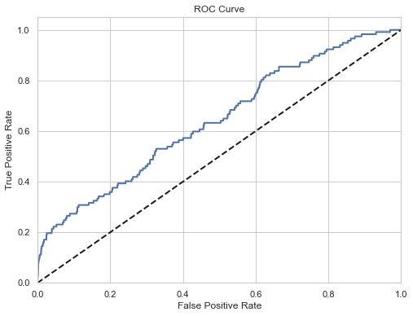
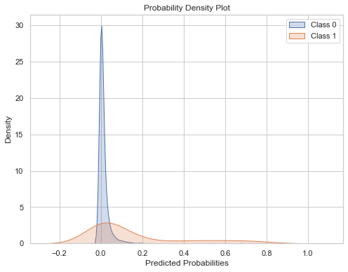

The Ultimate Choice: Random Forest
98% Accuracy for Low risk
28% Accuracy for High Risk
Precision: Precision for 'not high risk' is high at 99%, but for 'high risk,' it's only 28%.
Recall: Good recall for 'not high risk' at 99%, while for 'high risk,' it's 13%.
F1-Score: The F1-score for 'not high risk' is high at around 0.99, but for 'high risk,' it's 0.18.
Confusion Matrix: Most predictions are correct for 'not high risk' (7136 out of 7292) but relatively few for 'high risk' (15 out of 117).
ROC AUC Score: The model's ability to distinguish between high-risk and non-high-risk cases is moderate, with a score of approximately 0.56.
Notes:
The time has come for a crucial decision - choosing our path forward.
We've made our ultimate choice: the Random Forest. It's our trusty companion for the road ahead, our companion in unveiling the mysteries of low-risk identification.
The eureka moment arrives, and it's nothing short of exhilarating. We reveal the true power of our model.
It's not just about high-risk applicants anymore; it's about mastering the art of identifying the low-risk gems, the unsung heroes of credit card approvals.

Slide 7
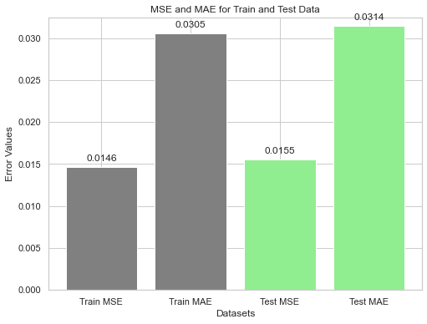
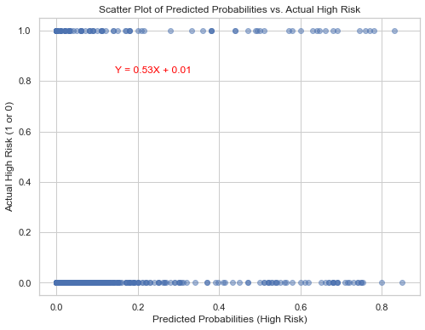
The Power of Model
Both training and test data exhibit low MSE and MAE values, indicating the model's effectiveness in minimizing prediction errors and its ability to generalize well to unseen data.
Train Data
Test Data
Train MSE: 0.0146 indicates small squared differences between predicted and actual values in the training data, reflecting a good model fit.
Train MAE: Approximately 0.0305 signifies small absolute differences between predicted and actual values in the training data, indicating an accurate model fit.
Test MSE: Around 0.0155 shows small squared differences between predicted and actual values in the test data, indicating strong model generalization.
Test MAE: Approximately 0.0314 suggests small absolute differences between predicted and actual values in the test data, confirming good model generalization.
Notes:
Our journey leads to a transformative moment in the credit card landscape.
We've honed our precision in identifying low-risk applicants. The results speak for themselves. We've achieved what we set out to do, and more.
Now, we return as heroes, holding the elixir of success - higher approval rates.
Our quest's benefits extend beyond profitability. We've ensured compliance and enhanced customer satisfaction, leaving a lasting impact.

Slide 8
Ask Questions!

Slide 9
Thank you!
Sumali Wickramarachchi
sumaliwick11@gmail.com
GitHub: @SumaliWick
LinkedIn profile: Sumali Wickramarachchi
https://www.linkedin.com/in/sumali-wickramarachchi-3a296356/

